Slide 1

Learning Alfresco Forms Service By Examples
Yong Qu
Chief Solutions Architect
www.alfresco.com

Slide 2
Introduction
Forms Service (?) Prior to 3.2
  DM Forms vs. WCM Forms
  Customization /Extension possible but not easy.
Forms Service in 3.2
  First Step towards a SINGLE forms service for all Alfresco products.
  Easy to extend, customize and package.
  Community adoption and contribution will be key for its success.

Slide 3
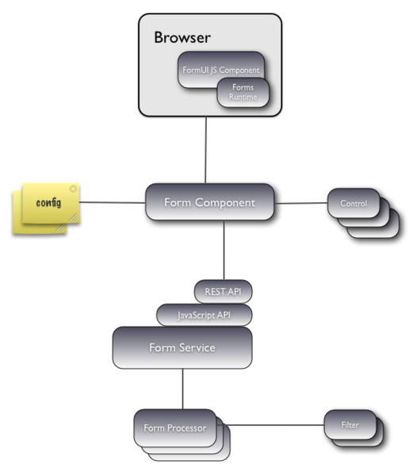
Architecture

Slide 4
Examples
Custom Controls.
  WYSIWYG Editor (TinyMCE )‏
  Auto Complete Picker
  Cascade Select
Custom Form Templates.
  Tab View
Custom Set Appearances.
  Accordion
Notes:
24/07/06

Slide 5
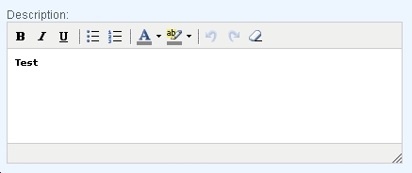
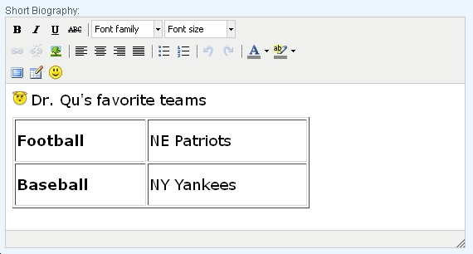
Custom Control
TinyMCE Editor
Generate Inline WYISWYG Editor for Text Field.
Support Control Parameters for
  Editor Width
  Editor Height
  Editor Appearance (Default, Full and Plugins)‏
Notes:
24/07/06

Slide 6
Custom Control
TinyMCE Editor (Cont.)‏
Form Configurations
……
<field id="cm:description">
<control template="/org/alfresco/components/form/controls/wysiwyg.ftl" />
</field>
<field id="forms32:bio">
<control template="/org/alfresco/components/form/controls/wysiwyg.ftl">
<control-param name="height">200</control-param>
<control-param name="width">420</control-param>
<control-param name="appearance">plugins</control-param>
</control>
</field>
......
Notes:
24/07/06

Slide 7
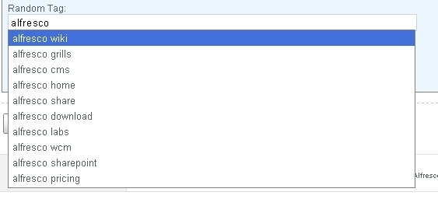
Custom Control
Auto Complete Picker
Generate an Auto Complete Selection List .
Notes:
24/07/06

Slide 8
Custom Control
Auto Complete Picker (Cont.)‏
Control Components:
  External Services (e.g. Google Suggest, Yahoo Suggest etc.)‏
  Local Alfresco Web Script Services to provide nicely formatted local data sources for YUI Widgets.
  YUI Auto Complete Widget to generate the selection list.
External
Services
Local Web
Script Services
“remote”
Picker Control
YUI Auto Complete Widget
Notes:
24/07/06

Slide 9
Custom Control
Auto Complete Picker(Cont.)‏
Form Configurations
……
<field id="forms32:tag">
<control template="/org/alfresco/components/form/controls/autocomplete.ftl">
<control-param name="ds">/share/service/ds/autocomplete/google</control-param>
</control>
</field>
......
Notes:
24/07/06

Slide 10
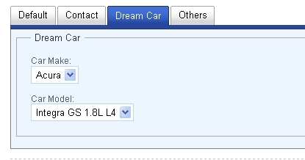
Custom Control
Cascade Select
Generate two or multiple dependent selects.
Notes:
24/07/06

Slide 11
Custom Control
Cascade Select (Cont.)‏
Parent
Select Control
Data Sources
Initial Value
Populated Event
Value
Change Event
Child
Select Control
Data Sources
Notes:
24/07/06

Slide 12
Custom Control
Cascade Select (Cont.)‏
Form Configurations
……
<field id="forms32:carmake" set="dreamcar">
<control template="/org/alfresco/components/form/controls/cascadeselect.ftl">
<control-param name="ds">/share/service/ds/cars/list</control-param>
</control>
</field>
<field id="forms32:carmodel" set="dreamcar">
<control template="/org/alfresco/components/form/controls/cascadeselect.ftl">
<control-param name="ds">/share/service/ds/cars/{parent}</control-param>
<control-param name="parent">forms32_carmake</control-param>
</control>
</field>
......
Notes:
24/07/06

Slide 13
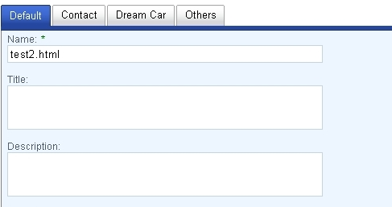
Custom Form Template
Tab View
Create Navigable Tabbed View of Form Fields.
Notes:
24/07/06

Slide 14
Custom Control
Cascade Select (Cont.)‏
Form Configurations
……
<config evaluator="node-type" condition="forms32:userprofile">
<forms>
<form>
<view-form template="/tab-edit-form.ftl" />
<edit-form template="/tab-edit-form.ftl" />
<create-form template="/tab-edit-form.ftl" />
……
</form>
</forms>
</config>
......
Notes:
24/07/06

Slide 15
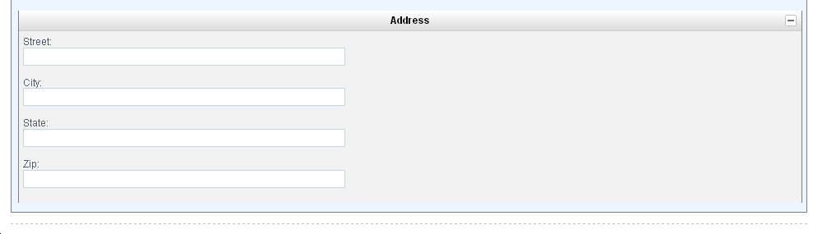
Custom Set Appearance
Accordion View
Generate Accordion View of Set Fields.
Notes:
24/07/06

Slide 16
Custom Set Appearance
Accordion (Cont.)‏
Form Configurations
……
<set id="addressset" parent="contactset" appearance="accordion" label="Address" />
……
<field id="forms32:street" set="addressset"/>
<field id="forms32:city" set="addressset"/>
<field id="forms32:state" set="addressset"/>
<field id="forms32:zip" set="addressset"/>
......
Notes:
24/07/06

Slide 17
To-Do List or Wish List
Custom Set Templates.
Custom Form Service Filters.
Custom Field Validators.
Improve Field Validation JavaScript.
Integration with Third-party Products.
More Pluggable Custom Set Appearances.
Less Reboots during Form Development.
Visual Form Builder.
Notes:
24/07/06

Slide 18
Install the Examples
Install forms-32.amp.
  Place the amp file under amps folder of your Alfresco instance.
  Run apply_amps.bat or apply_amps.sh.
Install forms-32-share.zip.
  Unzip the zip file to the root folder of your share webapp.
Restart Alfresco.
Log on Alfresco Web Explore and Create a new document of the User Profile type.
Locate the NodeRef of the newly create document.
Browse to the Form Test page and enter the NodeRef in the ID field of the Item Details section.
  http://localhost:8080/share/page/form-test
Click on the Show Form button.
Notes:
24/07/06

Slide 19
Source Code
Project Home
http://code.google.com/p/alfresco-forms-service-examples/

